Slide 1
CLOUD COMPUTING, SECURITY AND PRIVACY
CLOUD COMPUTING, SECURITY AND PRIVACY
CLOUD COMPUTING, SECURITY AND PRIVACY

Slide 2
Course Objectives:
This course will enable students to:
Discuss the concepts, characteristics, delivery models and benefits of cloud computing.
Explore the key technical, organisational and compliance challenges of cloud computing.
Explore the security issues that arise from cloud computing architectures intended for delivering Cloud based enterprise IT services.

Slide 3
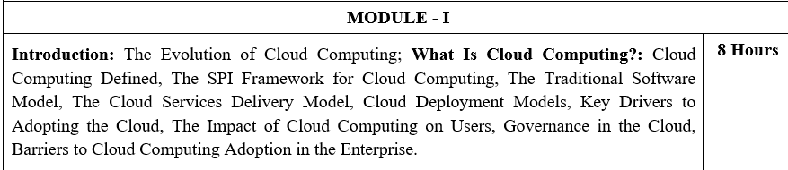

Slide 4
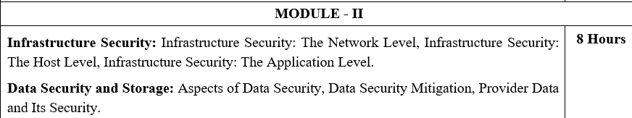

Slide 5
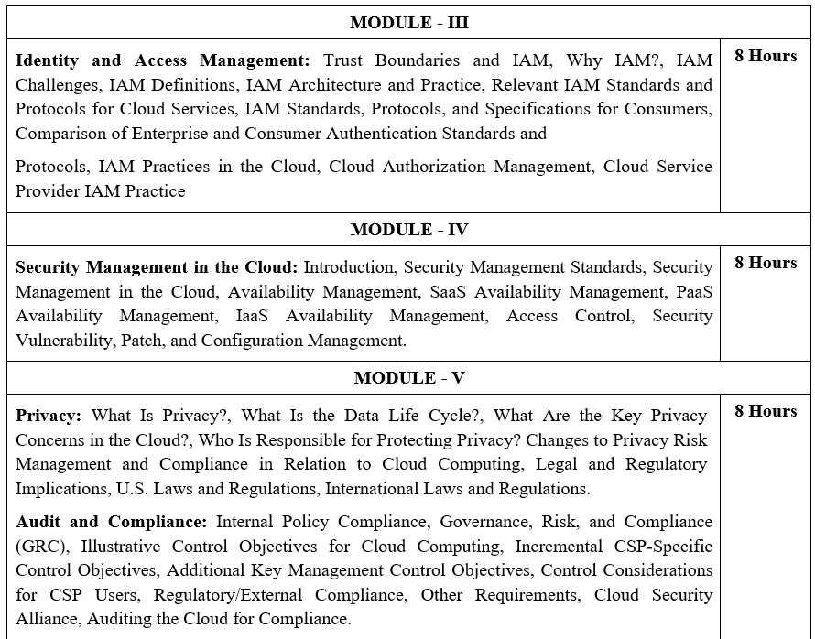

Slide 6
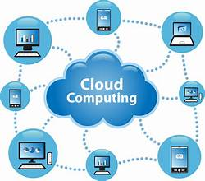
Cloud Computing
Cloud computing is the delivery of computing resources over the internet, or "the cloud", on a pay-as-you-go basis.
Standard definition of cloud computing is based on five attributes: multitenancy (shared resources), massive scalability, elasticity, pay as you go, and self-provisioning of resources.

Slide 7
Multitenancy (shared resources)
Unlike previous computing models, which assumed dedicated resources (i.e., computing facilities dedicated to a single user or owner), Cloud computing is based on a business model in which resources are shared (i.e., multiple users use the same resource) at the network level, host level, and application level.

Slide 8
Traditional (previous) computing models
In the past, computing was often resource-dedicated.
Example:
A company bought its own servers.
Those servers were used only by that company.
All the processing power, storage, and applications were reserved for them.
Drawback: Expensive to buy and maintain, often underutilized because the capacity wasn’t always fully used.

Slide 9
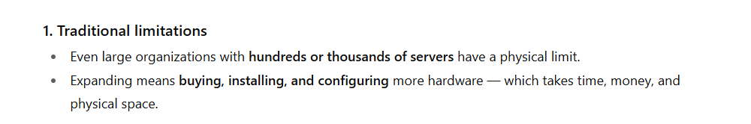
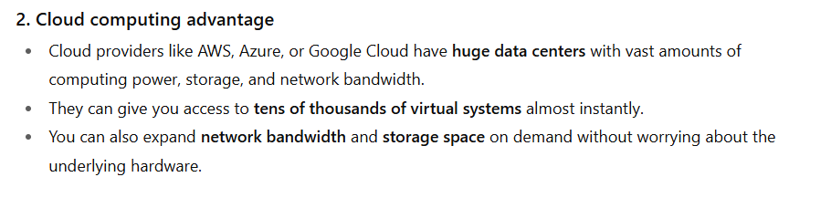
Massive scalability
Although organizations might have hundreds or thousands of systems, cloud computing provides the ability to scale to tens of thousands of systems, as well as the ability to massively scale bandwidth and storage space.

Slide 10
Pay as you go
Users pay for only the resources they actually use and for only the time they require them.
Self-provisioning of resources
Users self-provision resources, such as additional systems (processing capability, software, storage) and network resources.

Slide 11
Elasticity
One of the attributes of cloud computing is elasticity of resources. This cloud capability allows users to increase and decrease their computing resources as needed,
There is always an awareness of the baseline of computing resources, but predicting future needs is difficult, especially when demands are constantly changing.
Cloud computing can offer a means to provide IT resources on demand and address spikes in usage.

Slide 12
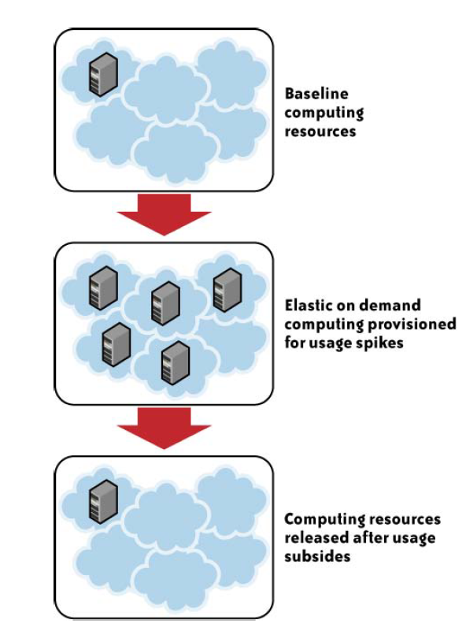
Fig: Attribute of Elasticity

Slide 13
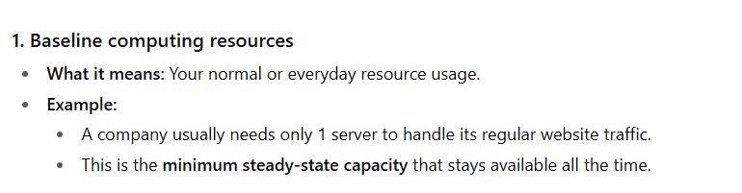
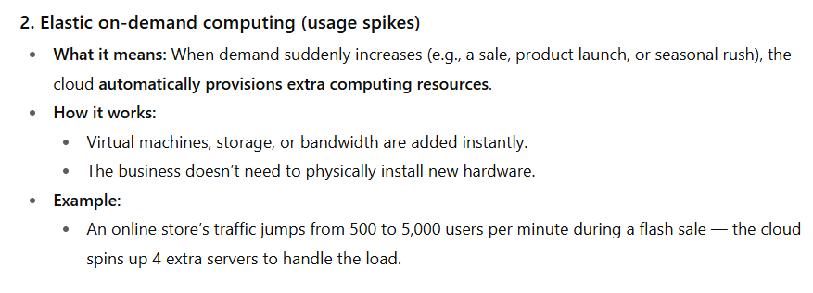

Slide 14
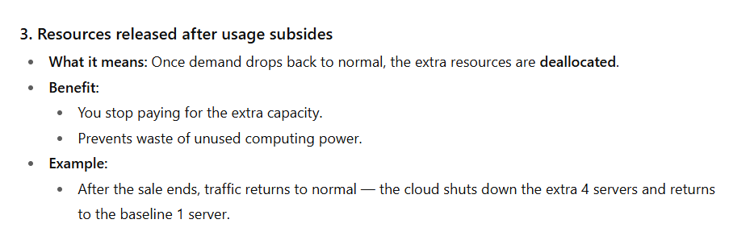

Slide 15
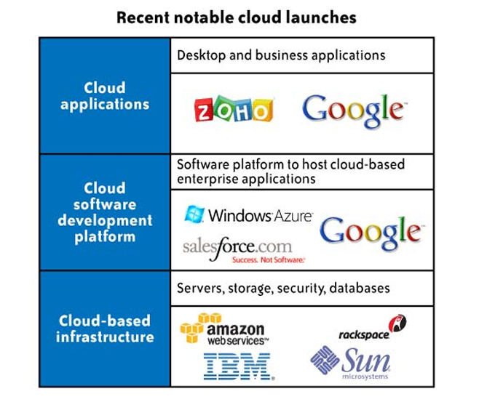

Slide 16
The SPI Framework for Cloud Computing
A commonly agreed upon framework for describing cloud computing services goes by the acronym “SPI.” This acronym stands for the three major services provided through the cloud:
software-as-a-service (SaaS), platform-as-a-service (PaaS), and infrastructure-as-a-service(IaaS).
Figure illustrates the relationship between services, uses, and types of clouds.

Slide 17
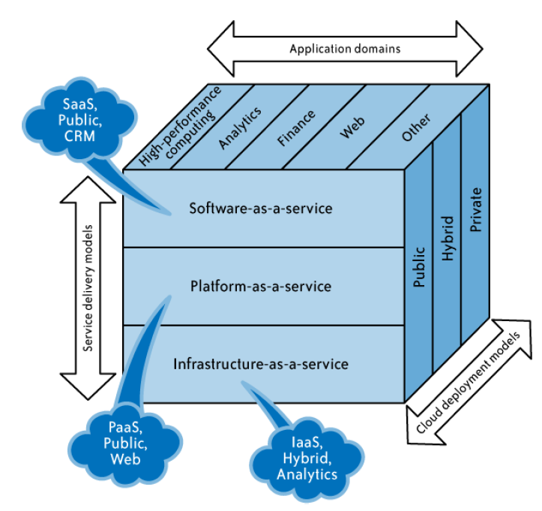

Slide 18
Relevant Technologies in Cloud Computing
Cloud computing isn’t so much a technology as it is the combination of many pre existing technologies.
These technologies have matured at different rates and in different contexts, and were not designed as a coherent whole; however, they have come together to create a technical ecosystem for cloud computing.
New advances in processors, virtualization technology, disk storage, broadband Internet connection, and fast, inexpensive servers have combined to make the cloud a more compelling solution.

Slide 19
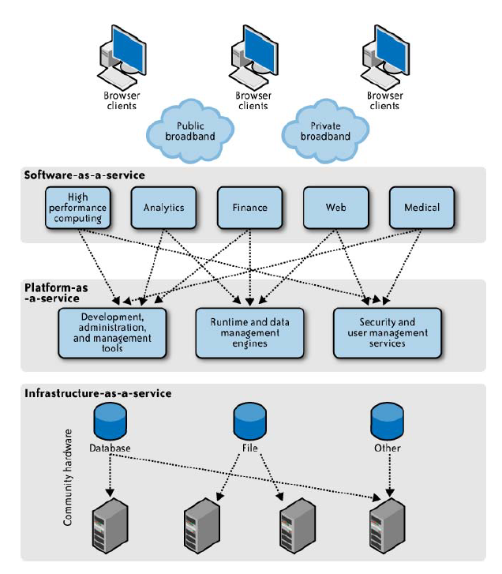
Architecture for relevant technologies

Slide 20
1. Browser Clients & Connectivity
Users (browser clients) connect to cloud services via:
Public broadband (e.g., the Internet)
Private broadband (e.g., corporate network/VPN)
2. Software-as-a-Service (SaaS) — Top Layer
SaaS delivers complete applications over the internet.
Users don’t manage infrastructure or platforms — they just use the application.
Examples shown in the diagram:
High performance computing (e.g., simulations, scientific calculations)
Analytics (e.g., BI tools)
Finance (e.g., online banking, ERP finance modules)
Web (e.g., website hosting, CMS)
Medical (e.g., telemedicine platforms)

Slide 21
3. Platform-as-a-Service (PaaS) — Middle Layer
Provides tools and environments to build, test, and deploy applications.
Examples in the diagram:
Development, administration, and management tools
Runtime and data management engines (to execute code and manage data)
Security and user management services
4. Infrastructure-as-a-Service (IaaS) — Bottom Layer
Delivers the basic building blocks: servers, storage, and networking.
Examples in the diagram:
Database storage
File storage
Other infrastructure resources
These are community hardware resources hosted by cloud providers.

Slide 22
Cloud access devices
The range of access devices for the cloud has expanded in recent years.
Home PCs, enterprise PCs, network computers, mobile phone devices, custom handheld devices, and custom static devices (including refrigerators) are all online.

Slide 23
Browsers and thin clients
Users of multiple device types can now access applications and information from wherever they can load a browser.
Indeed, browsers are becoming increasingly sophisticated.
Enterprise applications, such as SAP and Oracle, can be accessed through a browser interface—a change from when a client (a so-called “fat”) application needed to be loaded onto the desktop.

Slide 24
High-speed broadband access : A critical component of the cloud is the broadband network, which offers the means to connect components and provides one of the substantial differences from the utility computing concept of 30 years ago.
Data centers and server farms Cloud-based services require large computing capacity and are hosted in data centers and server farms. These distributed data centers and server farms span multiple locations and can be linked via internetworks providing distributed computing and service delivery capabilities.

Slide 25
Storage devices Decreasing storage costs and the flexibility with which storage can be deployed have changed the storage landscape. The fixed direct access storage device (DASD) has been replaced with storage area networks (SANs), which have reduced costs and allowed a great deal more flexibility in enterprise storage.
SAN software manages integration of storage devices and can independently allocate storage space on demand across a number of devices.

Slide 26
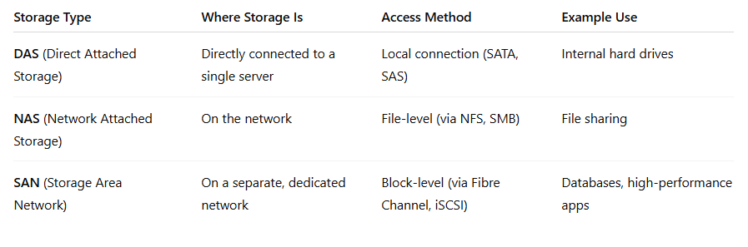
A SAN is a high-speed, specialized network that connects storage devices (like disk arrays and tape libraries) to servers.
Its main job: provide block-level storage that looks to the server like a directly attached disk.
A bank with many application servers uses a SAN to store customer transaction records.
All servers can access the same storage pool.
If one server fails, another can quickly take over without data loss.

Slide 27
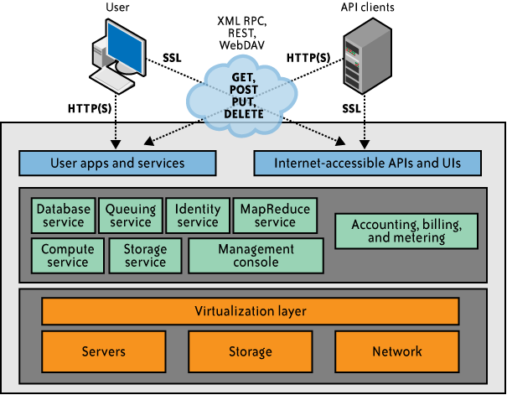
API enabler for cloud computing

Slide 28
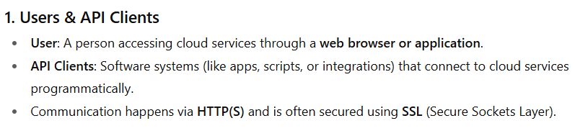
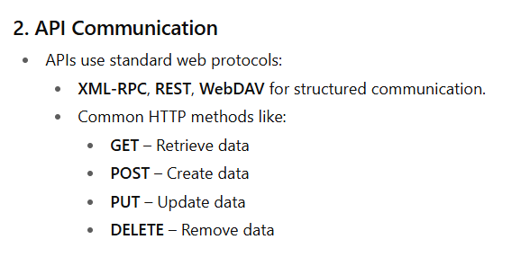
APIs (Application Programming Interfaces) act as an enabler for cloud computing, allowing users and applications to interact with cloud services securely and efficiently.

Slide 29
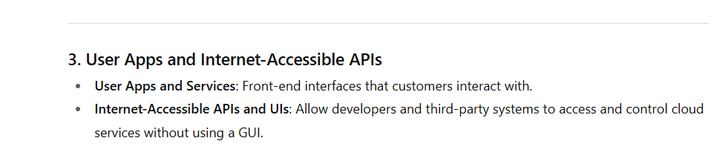
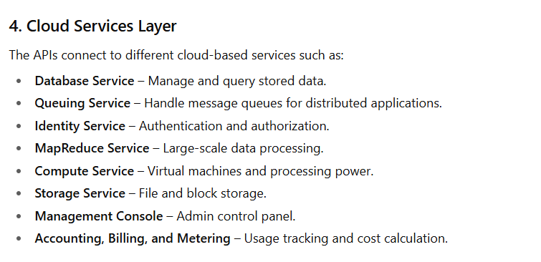

Slide 30
APIs are the bridge between the user or application and the underlying cloud infrastructure
They make cloud computing flexible, programmable, and automatable, enabling integration with other systems and applications.

Slide 31
A suitable application programming interface (API) is another enabler for the cloud computing services delivery model
APIs empower users by enabling features such as self provisioning and programmatic control of cloud services and resources.
Depending on the type of cloud services delivery model (SPI), an API can manifest in different forms, ranging from simple URL manipulations to advanced SOA-like programming models.
APIs also help to exploit the full potential of cloud computing and mask the complexity involved in extending existing IT management processes and practices to cloud services.
Service-oriented architecture (SOA) is an architectural style that focuses on discrete services instead of a monolithic design.

Slide 32
APIs offered by IaaS cloud service providers (CSPs) such as Amazon EC2, Sun Cloud, and GoGrid allow users to create and manage cloud resources, including compute, storage, and networking components.

Slide 33
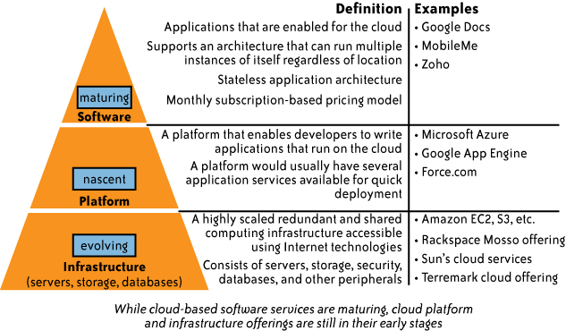
The Cloud Services Delivery Model

Slide 34
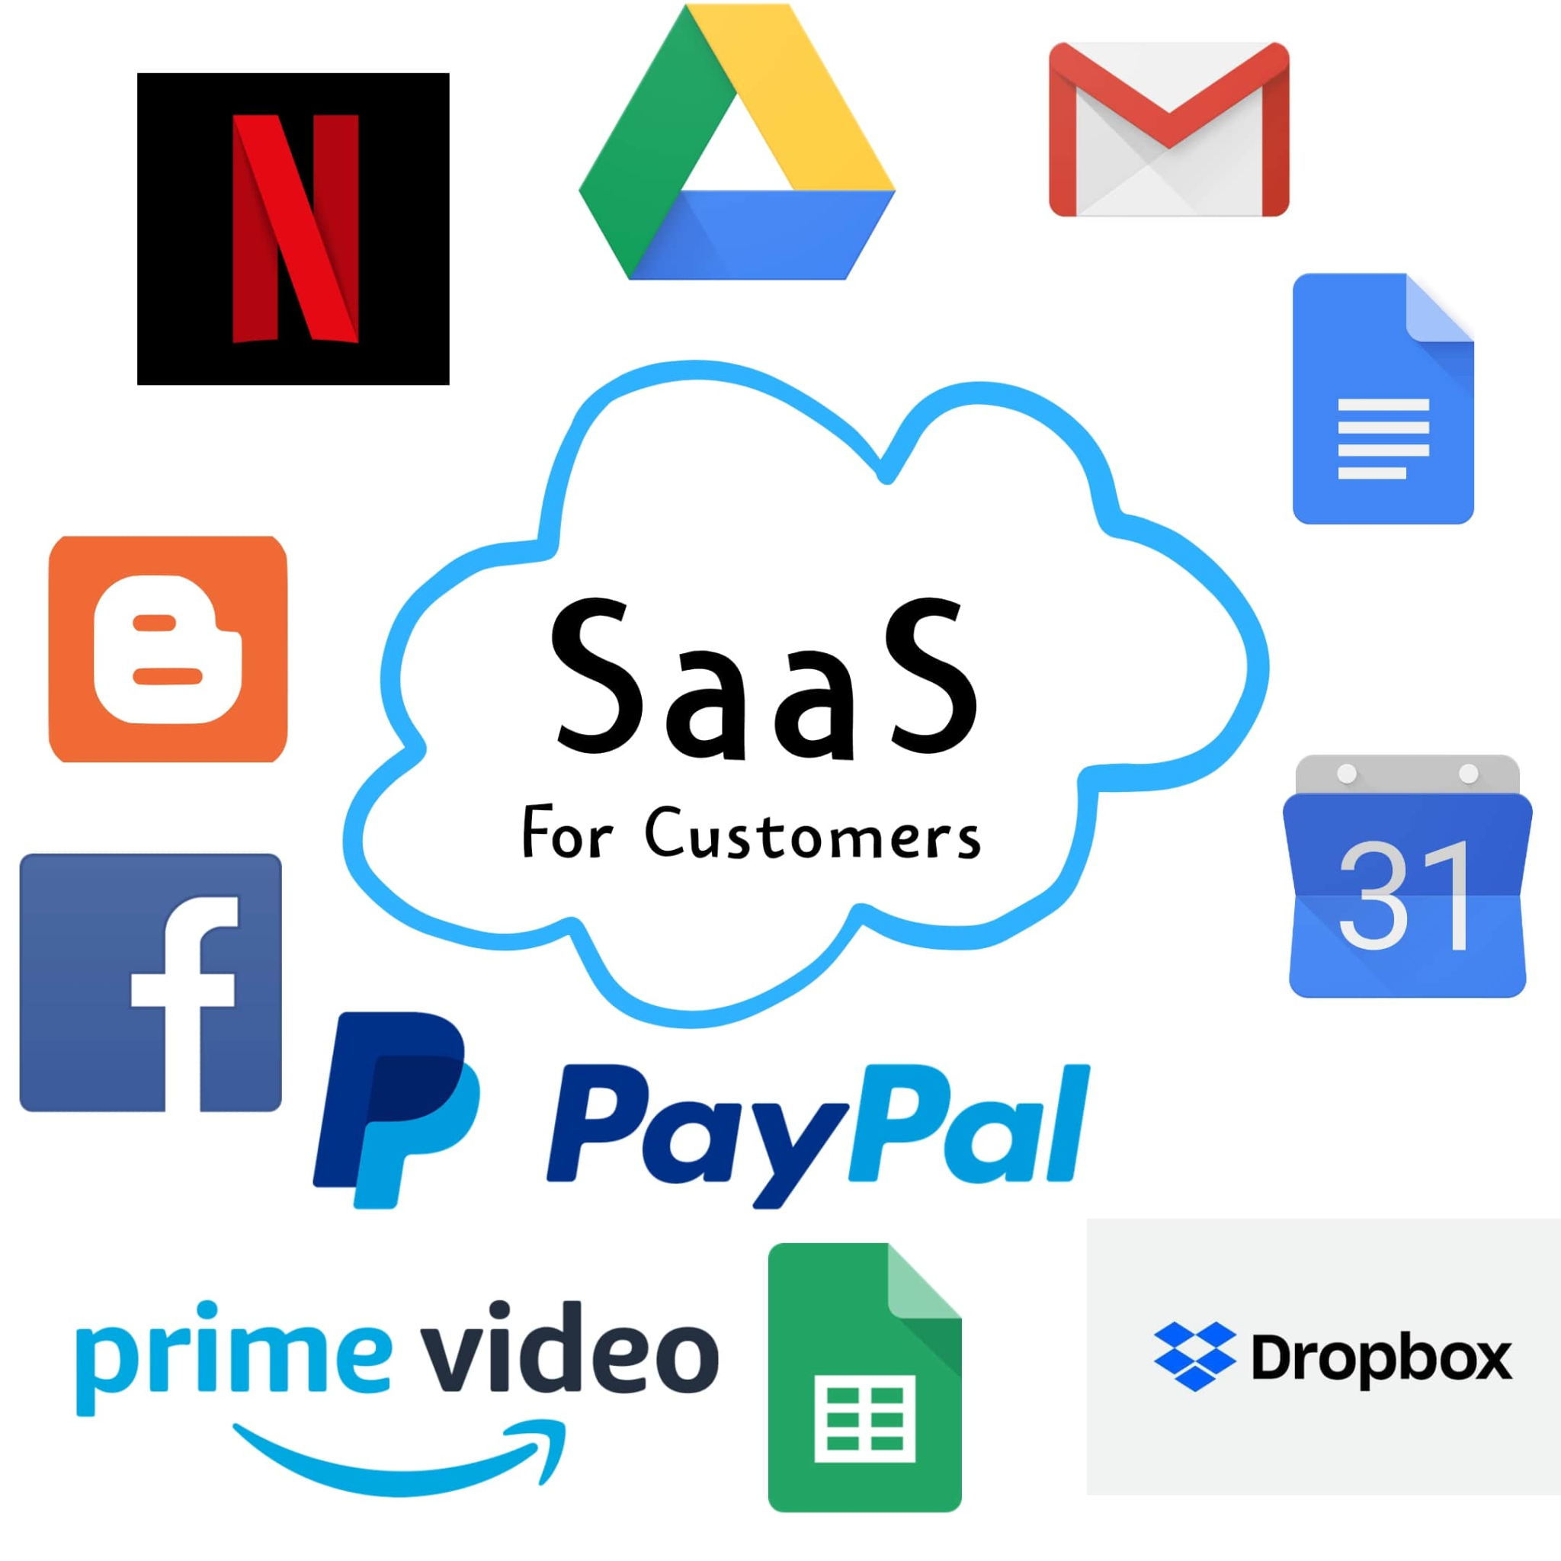
The Software-As-a-Service Model
Traditional methods of purchasing software involved the customer loading the software on his own hardware in return for a license fee (a capital expense, known as CapEx).
The customer could also purchase a maintenance agreement to receive patches to the software or other support services.
The customer was concerned with the compatibility of operational systems, patch installations, and compliance with license agreements.

Slide 35
In a SaaS model, the customer does not purchase software, but rather rents it for use on a subscription or pay-per-use model (an operational expense, known as OpEx).
In some cases, the service is free for limited use.
Typically, the purchased service is complete from a hardware, software, and support perspective.
The user accesses the service through any authorized device.

Slide 36
Key benefits of a SaaS model include the following:
SaaS enables the organization to outsource the hosting and management of applications to a third party (software vendor and service provider) as a means of reducing the cost of application software licensing, servers, and other infrastructure and personnel required to host the application internally.

Slide 37
2.
SaaS enables software vendors to control and limit use, prohibits copying and distribution,and facilitates the control of all derivative versions of their software.
SaaS centralized control often allows the vendor or supplier to establish an ongoing revenue stream with multiple businesses and users without preloading software in each device in an organization.

Slide 38
3.
Applications delivery using the SaaS model typically uses the one-to-many delivery approach, with the Web as the infrastructure.
An end user can access a SaaS application via a web browser; some SaaS vendors provide their own interface that is designed to support features that are unique to their applications.

Slide 39
4. A typical SaaS deployment does not require any hardware and can run over the existing Internet access infrastructure. Sometimes changes to firewall rules and settings may be required to allow the SaaS application to run smoothly.
5. Management of a SaaS application is supported by the vendor from the end user
perspective, whereby a SaaS application can be configured using an API, but SaaS
applications cannot be completely customized.

Slide 40
The Platform-As-a-Service Model
In a platform-as-a-service (PaaS) model, the vendor offers a development environment to application developers, who develop applications and offer those services through the provider’s platform.
The provider typically develops toolkits and standards for development, and channels for distribution and payment.
The provider typically receives a payment for providing the platform and the sales and distribution services.

Slide 41
PaaS solutions are development platforms for which the development tool itself is hosted in the cloud and accessed through a browser.
With PaaS, developers can often build web applications without installing any tools on their computer, and can then deploy those applications without any specialized system administration skills.

Slide 42
At a minimum, a PaaS solution should include the following elements:
A PaaS development studio solution should be browser-based.
An end-to-end PaaS solution should provide a high-productivity integrated development environment (IDE) running on the actual target delivery platform so that debugging and test scenarios run in the same environment as production deployment
A PaaS solution should provide integration with external web services and databases.
A PaaS solution must provide comprehensive monitoring of application and user activity, to help developers understand their applications and effect improvements.

Slide 43
Scalability, reliability, and security should be built into a PaaS solution without requiring additional development, configuration, or other costs
A PaaS solution must support both formal and on-demand collaboration throughout the entire software life cycle (development, testing, documentation, and operations), while maintaining the security of source code and associated intellectual property.
A PaaS solution should support pay-as-you-go metered billing.

Slide 44
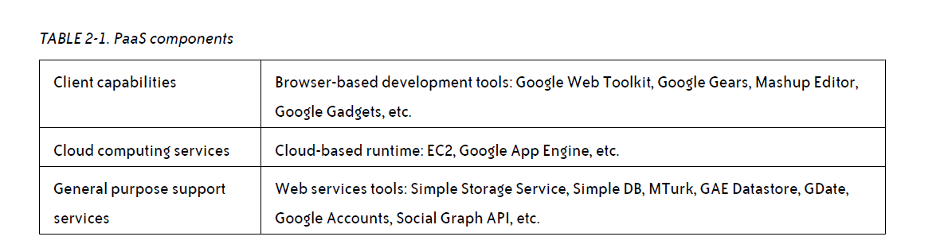

Slide 45
PaaS platforms also have functional differences from traditional development platforms including:
Multitenant development tools :Traditional development tools are intended for a single user; a cloud-based studio must support multiple users, each with multiple active projects.
Multitenant deployment architecture Scalability is often not a concern of the initial development effort and is left instead for the system administrators to handle when the project deploys.
In PaaS, scalability of the application and data tiers must be built-in (e.g., load balancing and failover should be basic elements of the developing platform).

Slide 46
Integrated management
Traditional development solutions (usually) are not associated with runtime monitoring,
but in PaaS the monitoring ability should be built into the development platform.
Integrated billing
PaaS offerings require mechanisms for billing based on usage that are unique to the SaaS world.

Slide 47
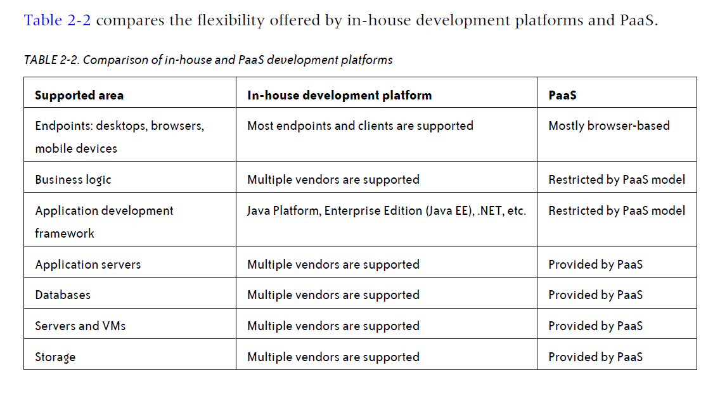

Slide 48
The Infrastructure-As-a-Service Model
In the traditional hosted application model, the vendor provides the entire infrastructure for a customer to run his applications.
Often, this entails housing dedicated hardware that is purchased or leased for that specific application.
The IaaS model also provides the infrastructure to run the applications, but the cloud computing approach makes it possible to offer a pay-per use model and to scale the service depending on demand.

Slide 49
Features available for a typical IaaS system include:
Scalability
The ability to scale infrastructure requirements, such as computing resources, memory, and storage (in near-real-time speeds) based on usage requirements
Pay as you go
The ability to purchase the exact amount of infrastructure required at any specific time
Best-of-breed technology and resources
Access to best-of-breed technology solutions and superior IT talent for a fraction of the cost

Slide 50
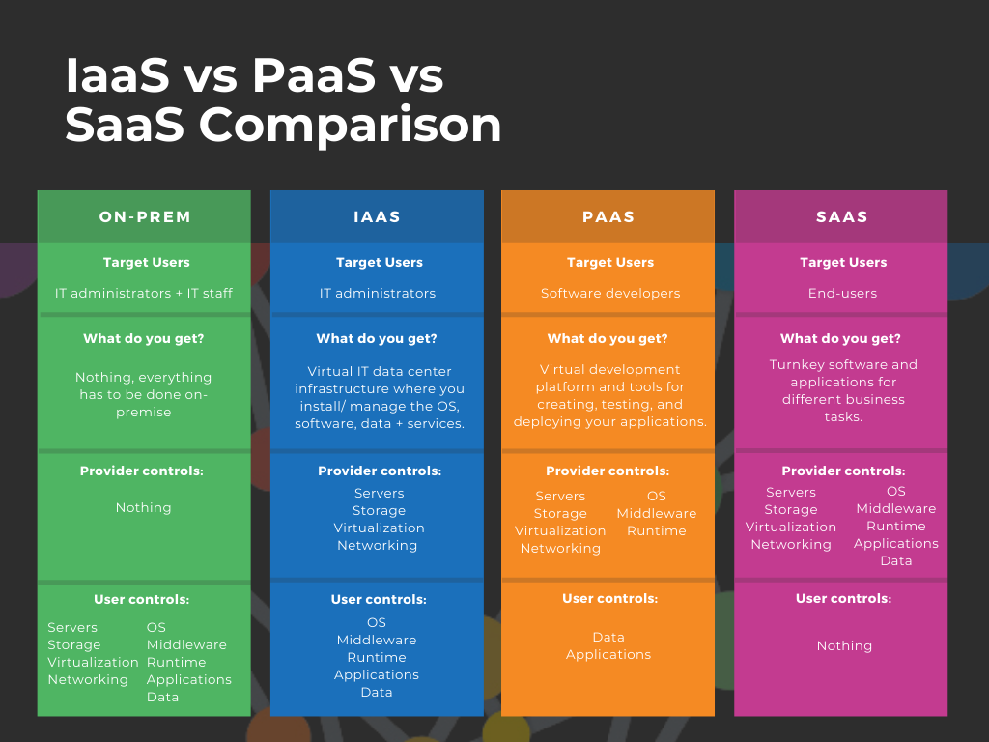

Slide 51
Cloud Deployment Models
Public Clouds
Public clouds (or external clouds) describe cloud computing in the traditional mainstream sense, whereby resources are dynamically provisioned on a fine-grained, self-service basis over the Internet, via web applications or web services, from an off-site, third-party provider who shares resources and bills on a fine-grained, utility-computing basis.

Slide 52
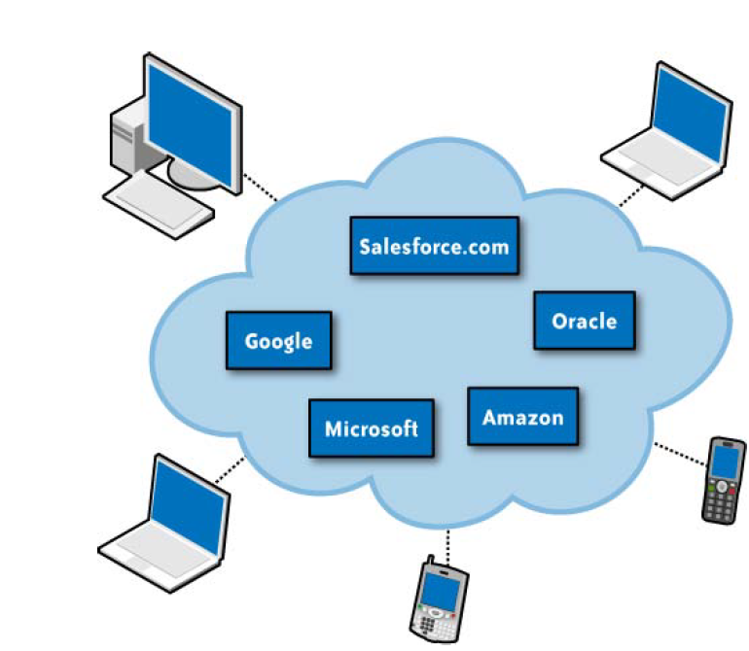
A public cloud is hosted, operated, and managed by a third-party vendor from one or more data centers.
The service is offered to multiple customers (the cloud is offered to multiple tenants) over a common infrastructure

Slide 53
In a public cloud, security management and day-to-day operations are relegated to the third party vendor, who is responsible for the public cloud service offering.
Hence, the customer of in the public cloud service offering has a low degree of control and oversight of the physical and logical security aspects of a private cloud.

Slide 54
Case Study: Dropbox – File Storage & Collaboration in the Public Cloud
Background
Dropbox is a popular file hosting and collaboration platform with over 700 million registered users. Initially, Dropbox used a mix of public cloud services and on-premises infrastructure. Over time, it relied heavily on Amazon Web Services (AWS) to scale its file storage and sharing capabilities before eventually building its own hybrid setup.

Slide 55
Why Public Cloud?
Rapid growth: Needed instant scalability during user expansion.
Global accessibility: Users in different countries require fast file uploads/downloads.
Focus on core service: Avoid building and maintaining physical data centers in early stages.
Public Cloud Services Used
Amazon S3 – Massive, durable storage for user files.
Amazon EC2 – Compute power for file indexing, search, and processing.
Amazon CloudFront – Content Delivery Network (CDN) to serve files quickly worldwide.
AWS IAM & KMS – Manage security, authentication, and encryption keys.

Slide 56
Advantages of Using Public Cloud
Scalability – Easily handles billions of file transactions daily without downtime.
Lower upfront cost – No need to invest in expensive hardware early on.
Global reach – Data replicated across regions for faster access.
Security features – Built-in encryption, identity management, and compliance tools.
Faster time-to-market – Ability to launch services quickly without waiting for infrastructure setup.

Slide 57
Disadvantages of Using Public Cloud
High long-term costs – Pay-as-you-go can become expensive at scale.
Vendor lock-in – Heavy reliance on AWS meant less flexibility to switch.
Data privacy concerns – Regulatory compliance challenges in certain countries.
Network dependency – Performance tied to internet connectivity and AWS uptime.

Slide 58
Outcome
Dropbox used AWS to quickly grow to millions of users.
Once stable and profitable, Dropbox migrated most storage to its own infrastructure ("Magic Pocket") to reduce long-term costs.
Still uses the public cloud for certain workloads and global distribution.

Slide 59
Private Cloud
A private cloud is a cloud computing environment dedicated to a single organization. It can be hosted on-premises (inside the company’s own data center) or by a third-party provider but is not shared with other customers.
Features:
Exclusive access and control.
Customizable for specific workloads.
Higher security and compliance.
Usually more costly to build and maintain compared to public cloud.

Slide 60
Private Clouds
Private clouds and internal clouds are terms used to describe offerings that emulate cloud computing on private networks.
These (typically virtualization automation) products claim to deliver some benefits of cloud computing without the pitfalls, capitalizing on data security, corporate governance, and reliability concerns.
Organizations must buy, build, and manage them and, as such, do not benefit from lower upfront capital costs and less hands-on management.
The organizational customer for a private cloud is responsible for the operation of his private cloud.

Slide 61
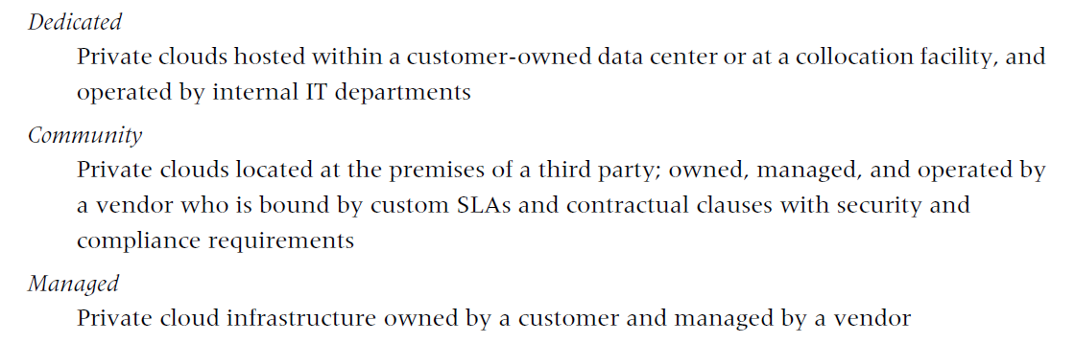
Private clouds differ from public clouds in that the network, computing, and storage infrastructure associated with private clouds is dedicated to a single organization and is not shared with any other organizations (i.e., the cloud is dedicated to a single organizational tenant).
Variety of private cloud patterns have emerged:

Slide 62
Case Study: NASA Nebula – Private Cloud for Space Research
NASA developed Nebula, its own private cloud computing platform, to handle the massive data processing needs of space missions and research projects.
Why Private Cloud?
Security: NASA deals with sensitive mission and research data.
Customization: Needed high-performance computing for space simulations and satellite imagery processing.
Data Control: Keep data on U.S. government–controlled infrastructure for compliance.

Slide 63
Implementation
Hosted in NASA’s own data centers at Ames Research Center.
Used OpenStack as the cloud management platform.
Provided Infrastructure-as-a-Service (IaaS) for researchers within NASA and selected partners.
Advantages
High Security & Privacy ->No external vendor access to sensitive mission data.
Custom-Built Performance →Tuned for computational-heavy workloads like image analysis from Hubble and Mars missions.
Regulatory Compliance →Fully aligned with U.S. government data protection rules.
Cost Control at Scale -> Reduced dependency on commercial cloud vendors.

Slide 64
Hybrid Cloud
A hybrid cloud combines public cloud and private cloud resources, enabling data and applications to move between them. This model allows organizations to balance scalability and cost-efficiency of public cloud with the security and control of private cloud.
Features
Flexibility – Choose where workloads run based on performance, security, or cost needs.
Scalability – Burst into public cloud when private resources are full.
Optimized Costs – Keep sensitive workloads on private cloud, run general workloads on public cloud.

Slide 65
Case Study: Netflix – Hybrid Cloud for Streaming & Operations
Background
Netflix uses AWS (public cloud) for its streaming platform and its own private data centers for content encoding, editing, and internal workloads.
Why Hybrid Cloud?
Global Scalability – AWS allows Netflix to serve millions of viewers worldwide without owning all infrastructure.
Content Security – Sensitive, unreleased video content is processed in Netflix’s private cloud to prevent leaks.
Disaster Recovery – Public cloud ensures service continuity if private systems fail.

Slide 66
Implementation
Private Cloud – Used in-house for video production, editing, and encoding.
Public Cloud (AWS) – Hosts the user-facing streaming service, recommendation algorithms, and analytics.
Data Flow – Once content is ready, it’s uploaded securely to AWS for global distribution.
Advantages
Best of Both Worlds – Public cloud scalability + private cloud security.
Cost-Effective – Use expensive private infrastructure only where necessary.
Improved Reliability – Failover between environments.

Slide 67
Disadvantages
Complex Management – Requires integration between two infrastructures.
Security Challenges – Data movement between environments must be secured.
Skill Requirements – Staff must manage multiple cloud systems.

Slide 68
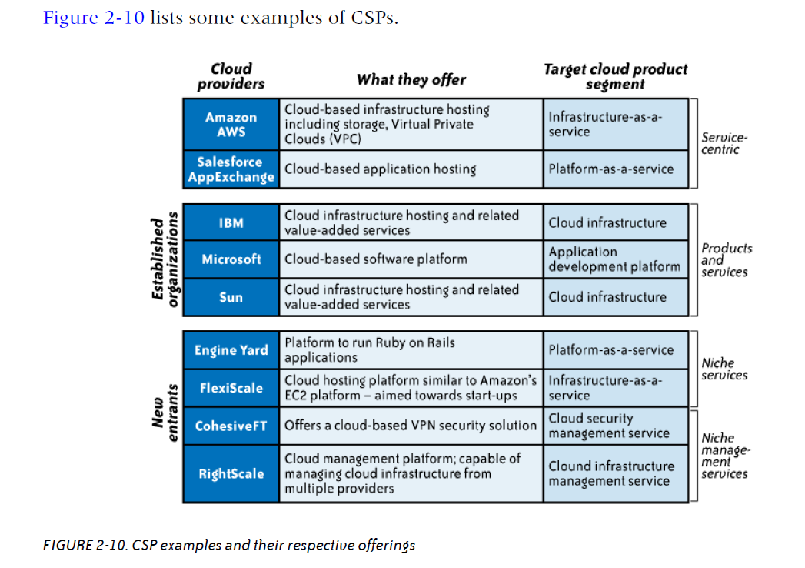

Slide 69
Key Drivers to Adopting the Cloud
Small Initial Investment and Low Ongoing Costs
Economies of Scale
Open Standards
Sustainability

Slide 70
Small Initial Investment and Low Ongoing Costs
Advantage: Small Initial Investment & Low Ongoing Costs in Public Cloud
1. No Capital Expenditure (CapEx)
In public cloud, companies don’t need to buy hardware, software, or networking equipment.
Eliminates expenses for servers, storage systems, and IT infrastructure setup.
Reduces the need for large IT teams to manage infrastructure.
2. Usage-Based Billing (Pay-as-You-Go)
Charges are based on actual consumption (compute hours, storage space, bandwidth, etc.).
No fixed monthly costs for unused capacity.
Aligns costs with demand — cheaper in low-usage periods.

Slide 71
3. Lower Barrier to Entry
Startups and small businesses can launch without huge upfront investments.
Makes enterprise-grade computing accessible to smaller organizations.
4. Flexible Contract Terms
Many providers allow short-term or on-demand contracts.
Contracts can be terminated or scaled down in times of hardship.
Helps manage budgets more efficiently.
Example A small e-commerce startup uses AWS EC2 instances to run its website:
Instead of buying ₹20 lakh worth of servers, it rents cloud capacity for ₹10,000/month.
During festive seasons, it scales up usage; in off-season, it reduces usage — paying only for what’s consumed.

Slide 72
Economies of Scale
Most development projects have a sizing phase during which one attempts to calculate the storage, processing power, and memory requirements during development, testing, and production.
It is often difficult to make accurate estimates; under- or overestimating these calculations is typical.
The lead time for acquiring the equipment to support these estimates can sometimes be lengthy, thus adding to the time necessary to complete the project

Slide 73
With the flexibility that cloud computing solutions offer, companies can acquire computing and development services as needed and on demand, which means development projects are less at risk of missing deadlines and dealing with the unknown

Slide 74
Case Study: Resource Sizing Challenge Solved with Cloud Computing
A mid-sized healthcare analytics company was developing a new patient data analytics platform. During the sizing phase, the IT team struggled to estimate:
Storage requirements for patient records.
Processing power for complex analytics.
Memory needs for real-time dashboards.
Their estimates varied widely between development, testing, and production phases.

Slide 75
Problem in Traditional On-Premises Setup
If they underestimated resources → the system would crash under heavy workloads.
If they overestimated → the company would waste money on unused servers.
Lead time for purchasing and configuring hardware was 6–8 weeks, delaying the project timeline.
Cloud-Based Solution
They adopted Microsoft Azure as a public cloud platform:
On-demand provisioning of virtual machines for development and testing.
Auto-scaling to handle spikes during production without manual intervention.
Pay-as-you-go billing so they only paid for extra resources when needed.

Slide 76
Outcome
Development started immediately without waiting for hardware procurement.
No wasted investment on oversized infrastructure.
Production system scaled automatically during high-demand periods (e.g., government health reporting deadlines).
Project completion time reduced by 2 months compared to initial estimates.

Slide 77
Open Standards in Cloud Computing
Open standards in cloud computing refer to publicly available specifications that ensure interoperability, portability, and flexibility across cloud platforms. They allow different systems, tools, and providers to work together without vendor lock-in.
Modular Architecture
Definition: Cloud systems are built in independent, interchangeable modules.
Benefits:
Enables rapid growth by adding or upgrading components without affecting the whole system.
Allows easy adaptation to changing user and business needs.
Supports scalability, making it easier to handle increased workloads over time.
Example: Adding extra storage modules in OpenStack without redesigning the entire infrastructure.

Slide 78
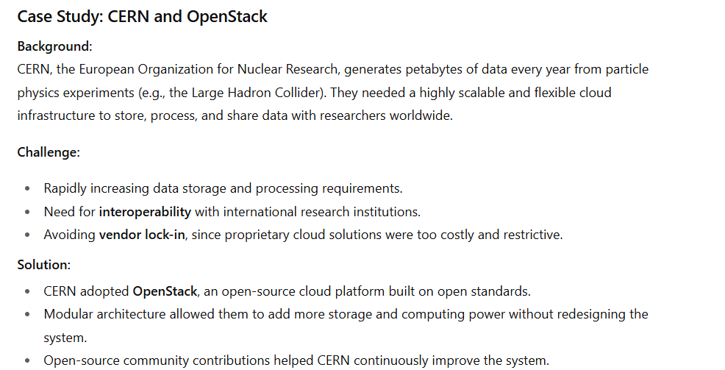

Slide 79
2. Open Source Software
Definition: Software whose source code is available under licenses in the public domain or meeting official open-source criteria.
Benefits:
Free usage — no licensing fees.
Modifiable — users can change the code to suit specific needs.
Collaborative improvement — large global communities contribute bug fixes, features, and security updates.
Example: Kubernetes (open-source container orchestration) is widely adopted in cloud deployments.

Slide 80
3. Flexibility and Growth
Flexibility: The ability to alter source code ensures continuous optimization and integration with other tools.
Growth Potential: Open-source foundations allow cloud providers and users to innovate faster, test new features, and expand services.
Example: OpenNebula allows enterprises to integrate private and public clouds seamlessly due to its modifiable source.
Summery……..
Open standards — supported by modular architecture and open-source software — are the backbone of cloud computing innovation. They ensure scalability, interoperability, and freedom from vendor lock-in, enabling continuous improvement and long-term growth.

Slide 81
Sustainability in Cloud Computing
Sustainability in cloud computing refers to building and operating cloud infrastructure in an energy-efficient, eco-friendly, and resilient way, ensuring minimal impact on the environment while meeting growing digital demands
CSP Investments:
Traditional IT Struggles:
Enhanced Resilience:

Slide 82
CSP Investments
Definition: Cloud Service Providers (CSPs) continuously invest in robust infrastructure and advanced technologies.
Impact:
Creation of resilient and stable environments.
Use of energy-efficient data centers and optimized hardware.
Continuous upgrades to meet growing demand and evolving security needs.
Example: Google Cloud’s investment in renewable-powered data centers for sustainable operations.

Slide 83
Case Study: Microsoft Azure – Investment in Green Data Centers
Background: Microsoft Azure, a major CSP, manages thousands of data centers worldwide to support cloud services for enterprises and governments.
Challenge:
High power consumption from large-scale infrastructure.
Need to maintain 99.99% uptime while cutting carbon emissions.
Rising demand for secure and sustainable cloud solutions.

Slide 84
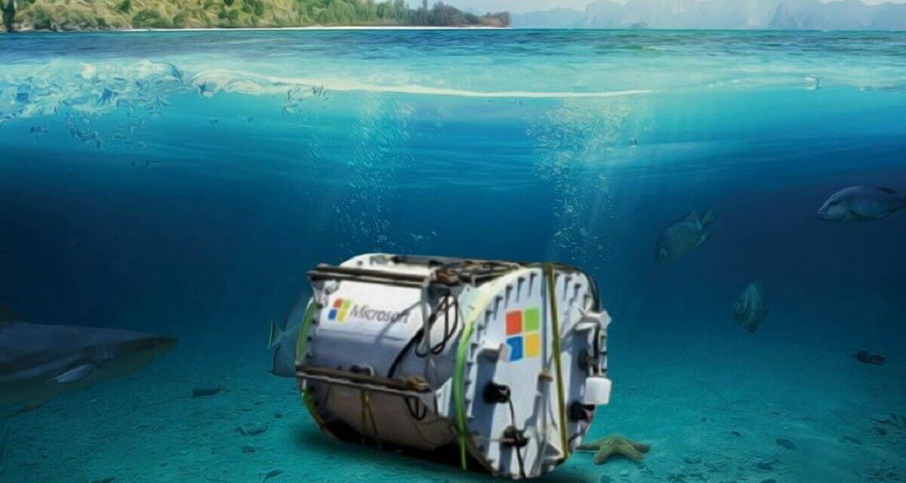
Solution:
Invested in underwater data centers (Project Natick) to reduce cooling costs.
Transitioned to 100% renewable energy by 2025 for all operations.
Integrated AI and IoT monitoring for predictive maintenance and resilience.

Slide 85
2. Traditional IT Struggles
Historically, companies faced:
Single points of failure (a single server crash could halt services).
Limited scalability due to fixed hardware capacity.
High maintenance costs and long upgrade cycles.
These issues reduced reliability and increased environmental waste from outdated hardware.
3. Enhanced Resilience with Cloud
Clustering: Multiple servers work together to handle workloads, reducing the impact of failures.
State-of-the-Art Solutions: Use of automated monitoring, predictive scaling, and AI-driven optimization.
Redundancy & Failover: CSPs replicate data and workloads across multiple regions, ensuring minimal downtime during outages.
Example: AWS Availability Zones ensure services stay up even if one data center fails.

Slide 86
Case Study: Netflix – Achieving Resilience with Cloud
Earlier, Netflix ran its services on traditional data centers.
During peak times, a single point of failure (like a server crash) caused long outages, impacting millions of users.
Scaling was hard because hardware upgrades took time, and maintenance costs were very high.
Challenge:
Outages in 2008 caused major disruptions.
Traditional IT could not handle unpredictable traffic spikes (e.g., when new shows were released).
Reliability was low, and customers lost trust due to downtime.

Slide 87
Cloud Solution:
Netflix migrated to Amazon Web Services (AWS).
Clustering: Services were split into microservices running across multiple servers, ensuring no single point of failure.
State-of-the-Art Solutions: Netflix built its own monitoring tools (e.g., Chaos Monkey) to test and improve resilience.
Redundancy & Failover: AWS Availability Zones replicated data across regions. If one data center failed, another took over seamlessly.

Slide 88
Netflix achieved 99.99% uptime globally.
They scaled automatically to serve over 230+ million users worldwide.
Maintenance costs reduced, and resilience increased.
Environmental impact was minimized by using shared cloud infrastructure instead of running large physical data centers.

Slide 89
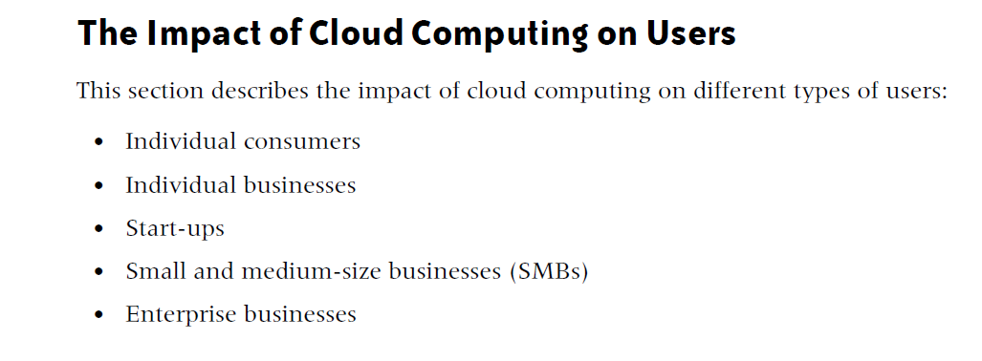

Slide 90
Individual Consumers:Cloud in Everyday Life
Email and storage: Most individuals use cloud-based email and storage services (e.g., Gmail, Google Drive).
Social networking: Platforms like Facebook, LinkedIn, and Twitter are cloud-based, storing vast amounts of personal data.
Media consumption: Streaming services (e.g., Netflix, Spotify) and online gaming rely heavily on cloud infrastructure.
Privacy concerns: High volumes of personal data stored in the cloud raise concerns about data privacy and security breaches.
Cloud-based applications: Consumers use cloud apps for fitness tracking, personal finance, and even tax preparation.

Slide 91
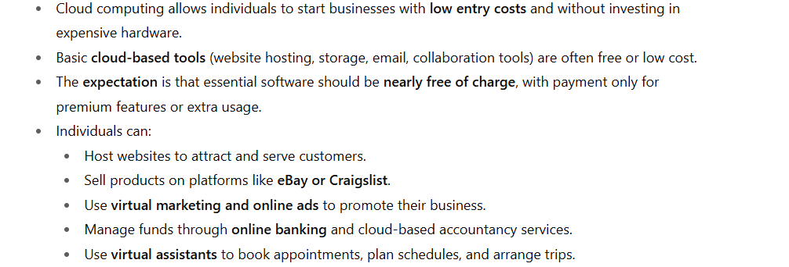
Individual Businesses

Slide 92
A freelance graphic designer wanted to start her own business with limited budget.
She could not afford expensive software, servers, or office space.
Cloud Adoption
Used Google Drive / Dropbox for storing and sharing design files with clients.
Subscribed to Canva Pro and Adobe Creative Cloud on a monthly basis instead of buying costly lifetime licenses.
Built a portfolio website using Wix (cloud-based hosting) to attract new clients.

Slide 93
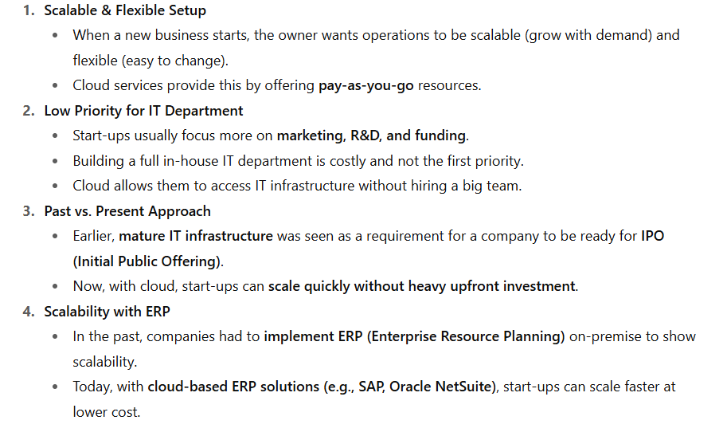
Start-ups and Cloud Computing

Slide 94
Start-ups
When a business owner starts up a new business, he wants to set up operation in a scalable, flexible fashion.
Building an IT department is a low priority compared to marketing the product, investing in research and development, or securing the next round of funding.
In the past, a mature IT infrastructure was a sign that a start-up company was ready for an initial public offering (IPO).
A company would demonstrate scalability by implementing a robust enterprise resource planning (ERP) solution and hosting it on the premises

Slide 95
Currently, a more common approach is to outsource the majority of IT and maintain a lean IT shop.
The challenge now becomes getting locked into provider contracts and the levels of service that the CSP will face.
Critical success factors are the ability to scale the infrastructure as volume increases, and rapidly modify the service for new product lines, channels, markets, or business models.

Slide 96
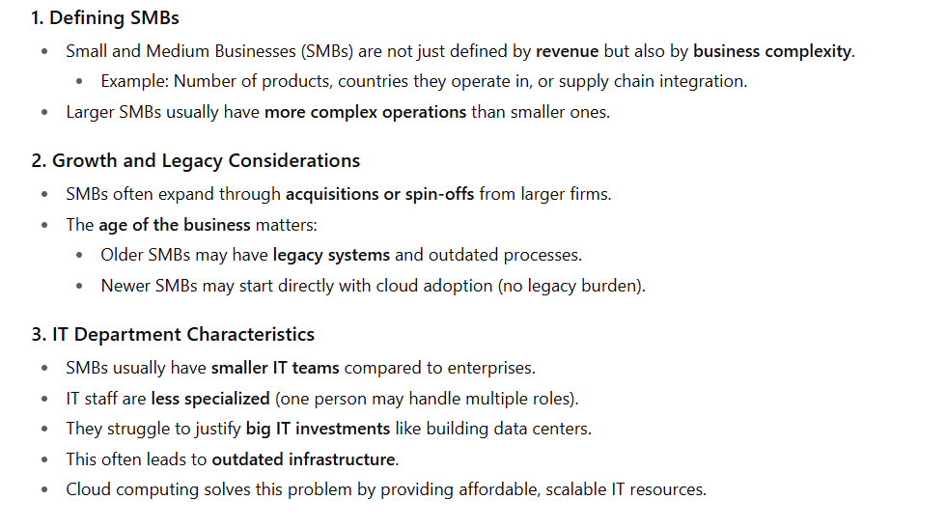
SMBs and Cloud Computing

Slide 97
4. Data Security and Privacy:
SMBs have similar data security and privacy requirements as larger enterprises.
5. Decision-Making Structure:
Fewer decision-makers compared to larger enterprises, which can streamline or hinder IT decisions.
6. Cloud Computing Opportunities:
SMBs can accelerate cloud adoption due to fewer in-house infrastructure constraints.
Complex SMBs may lead in cloud computing, relying on a mix of Cloud Service Providers (CSPs) for IT services.

Slide 98
Enterprise Businesses and Cloud Computing
1. Expanded Use of Cloud Services
Mature enterprises are increasingly using cloud platforms.
Earlier, cloud was mostly used for basic external services outside the company firewall.
Now, enterprises are moving beyond that — integrating cloud into mainstream operations and strategy.
2. Cloud for Personal Productivity
Employees rely on cloud-based tools for day-to-day activities such as:
Online research
Travel bookings
Scheduling
Enterprises also use cloud applications for non-sensitive corporate tasks, such as:
Employee surveys
Internal polls
Knowledge-sharing tools
This boosts efficiency without major security concerns.

Slide 99
3. Cloud in Business-Critical Functions
The big shift is the use of cloud for core enterprise functions like:
CRM (e.g., Salesforce.com)
Document management
Procurement & purchasing
Logistics & supply chain
Even sensitive data is being stored and managed in the cloud, showing growing trust in cloud security.
4. Security and Privacy Considerations
Enterprises weigh security & privacy risks against cost benefits of cloud adoption.
Best practice: maintain redundancy (duplicate data across both cloud and internal systems) to reduce risk of outages or breaches.

Slide 100
5. Risks of Vendor Lock-In
Using one provider’s proprietary architecture can create dependency.
This reduces flexibility, increases switching costs, and limits innovation.
Enterprises need to adopt open standards & multi-cloud strategies to avoid lock-in.
6. Time to Market as a Key Driver
Speed is often the main reason enterprises choose cloud.
When time and cost are critical (e.g., launching new products or entering new markets), cloud offers the fastest, most scalable solution.
In many cases, cloud becomes the only viable option.

Slide 101
Governance in the Cloud
Traditionally, most IT organizations govern the five technology layers shown ithe figure.
The two on-premises models indicate that IT has total control over (and responsibility for) all five technology layers.
However, as we move from IaaS to PaaS to SaaS, the IT organization’s level of control diminishes and the CSP’s level of control increases.
However, although control increases for the CSP, responsibility remains with the IT organization.
It is critical for IT organizations to develop strong monitoring frameworks over the SPI delivery model to ensure that their service levels and contractual obligations are met.

Slide 102
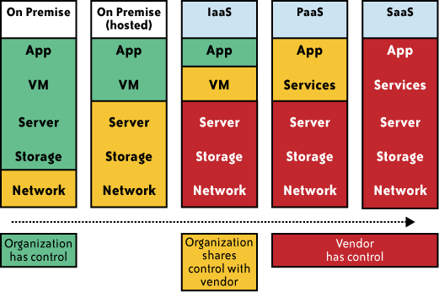

Slide 103
Barriers to Cloud Computing Adoption in the Enterprise
Security Concerns in Cloud Computing
Privacy in Cloud Computing
Connectivity and Open Access
Reliability in Cloud Computing

Slide 104
New computing model: Cloud computing introduces a new paradigm that affects how security is managed.
Levels of security:
Network Security: Protecting data as it travels over networks.
Host Security: Safeguarding the physical servers and virtual machines.
Application Security: Ensuring applications are secure from vulnerabilities and attacks.
Data Security: Protecting data at rest and in transit from unauthorized access.
Uncertainty and Risk: High levels of uncertainty about how well cloud providers manage these security aspects.
Executive Concerns: Security remains the top concern for information executives when considering cloud adoption.
Security Measures:
Encryption: Use of encryption to protect data.
Access Controls: Implementing robust access management policies.
Regular Audits: Conducting regular security assessments and audits.

Slide 105
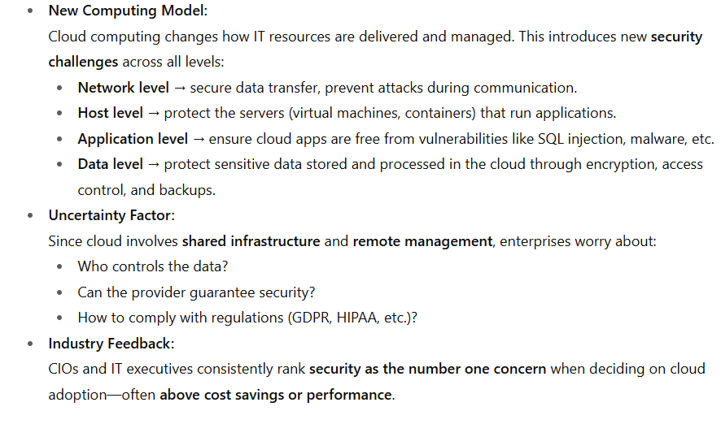
Security

Slide 106
Privacy
The ability of cloud computing to adequately address privacy regulations has been called into question.
Organizations today face numerous different requirements attempting to protect the privacy of individuals’ information, and it is not clear (i.e., not yet established) whether the cloud computing model provides adequate protection of such information, or whether organizations will be found in violation of regulations because of this new model.

Slide 107
Connectivity and Open Access
The full potential of cloud computing depends on the availability of high-speed access to all.
Such connectivity, rather like electricity availability, globally opens the possibility for industry and a new range of consumer products.
Connectivity and open access to computing power and information availability through the cloud promotes another era of industrialization and the need for more sophisticated consumer products.

Slide 108
Reliability
Enterprise applications are now so critical that they must be reliable and available to support 24/7 operations.
In the event of failure or outages, contingency plans must take effect smoothly, and for disastrous or catastrophic failure, recovery plans must begin with minimum disruption.

Slide 109
Independence from CSPs
Examples exist of IT outsourcing contracts that have effectively locked a customer into a service that does not meet current or evolving needs at a speed and cost that are acceptable to meet business goals.
This could be caused by a number of factors, and is a concern if limited options exist for quickly engaging an alternative provider supplier to meet the needs without large transition or penalty costs.

Slide 110
Changes in the IT Organization
The IT organization will be affected by cloud computing, as has been the case with other technology shifts.
There are two dimensions to shifts in technology. The first is acquiring the new skill sets to deploy the technology in the context of solving a business problem, and the second is how the technology changes the IT role.

Slide 111
Political Issues Due to Global Boundaries
In the cloud computing world, there is variability in terms of where the physical data resides, where processing takes place, and from where the data is accessed.
Given this variability, different privacy rules and regulations may apply.
Because of these varying rules and regulations, by definition politics becomes an element in the adoption of cloud computing, which is effectively multijurisdictional.
For example, as a result of the USA Patriot Act, Canada has recently asked that its government not use computers in the global network that are operating within U.S. borders, fearing for the confidentiality and privacy of the Canadian data stored on those computers.

